Slide 1


NJSBA WORKSHOP 2025
BUILDING EFFECTIVE RETURN-TO-WORK PROGRAMS

Slide 2

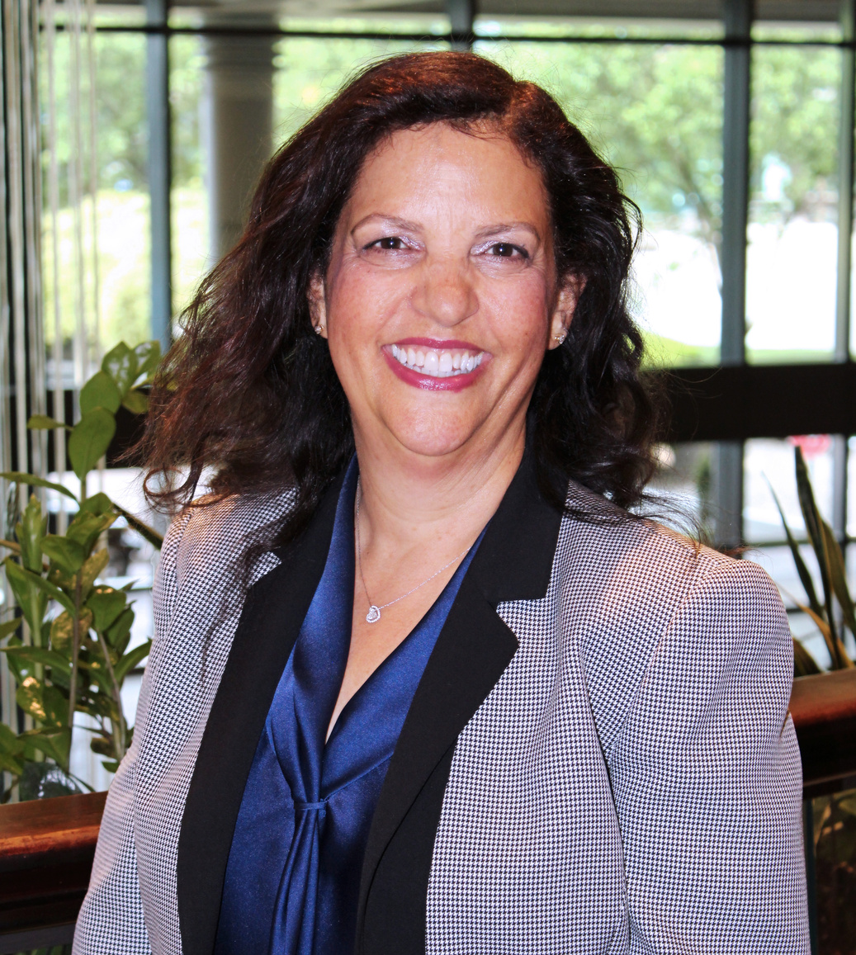

PRESENTERS
JILL DEITCH, ESQ.
Executive Director
NJSIG
JOANNA RADOMICKI
Member Services & Loss Control Rep.
NJSIG

Slide 3

DISCLAIMER
This presentation is intended as a summary only, and is not meant as legal advice or risk management advice. Please consult your attorney to obtain legal advice, and your risk management professional to obtain risk management advice.

Slide 4
WHO WE ARE
NJSIG is school board insurance group, AKA an insurance pool
•Provides insurance to NJ public schools only (workers’ compensation, general liability, auto liability, cyber, property, school board leader liability, excess/umbrella coverage)
•Public entity, does not operate for profit

Slide 5

RISK POOLS
  Coverages and policies focus on the needs of a particular group
    Examples: schools, municipalities
  Excess funds returned to members
  Deficits lead to reassessments (additional premiums)
  Most states (including NJ) require actuaries for loss estimates

Slide 6
TYPES OF INSURANCE
Hypothetical Budget: $12,000,000
(less than 10%)
  Medical/health
  Prescription
  Dental
  Vision
FOR SCHOOLS
EMPLOYEE
BENEFITS
Generally, the market for insurance for public schools in New Jersey can be divided into two broad segments:
Hypothetical school budget: ($125,000,000)
Hypothetical Budget: $1,000,000
(less than 1%)
  Workers’ compensation
  Commercial general liability
  Commercial vehicle liability
  School board leader liability
  Property
  Cyber
  And more…
PROPERTY
&
CASUALTY

Slide 7
PROPERTY
& CASUALTY
Lines of Coverage:
  Workers’ Compensation
  General Liability, Auto Liability
  Cyber
  Property
  School Board Leader Liability (E&O)
  Excess/Umbrella Coverage

Slide 8

LINES OF COVERAGE
WORKERS’ COMPENSATION
WHAT IT DOES:
  WC - Provides injured employees with predictable and prompt compensation for work-related injuries. In exchange for these benefits, employees give up their right to pursue a tort action – also known as a personal injury lawsuit – against their employers.
    In NJ, employers are required to show proof that they can meet their workers’ compensation obligations.
  WC typically represents approximately 55% of a school’s total Property & Casualty cost.
  Supplemental Indemnity (SI) provides 100% wage replacement for the first year of lost wages
WORKERS’ COMPENSATION (WC)
  SUPPLEMENTAL INDEMNITY (SI)

Slide 9
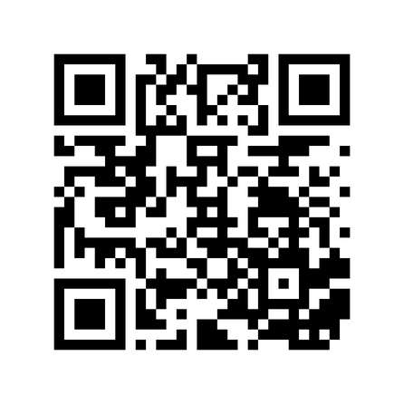
PRESENTER
JOANNA RADOMICKI
Member Services & Loss Control Rep.
NJSIG
Scan the QR code for more information

Slide 10
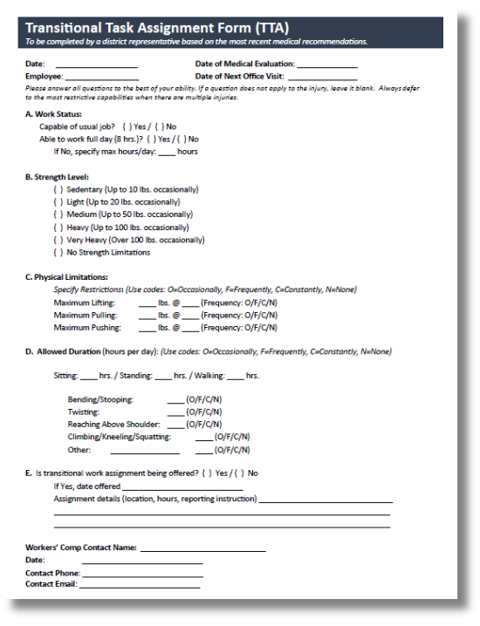
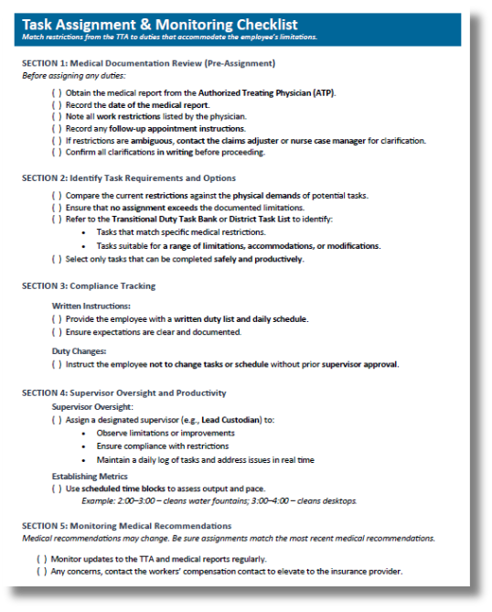
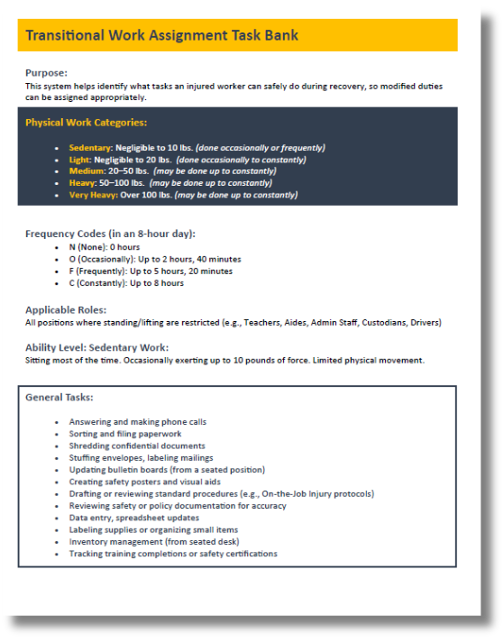

RETURN-TO-WORK
TOOLKIT

Slide 11

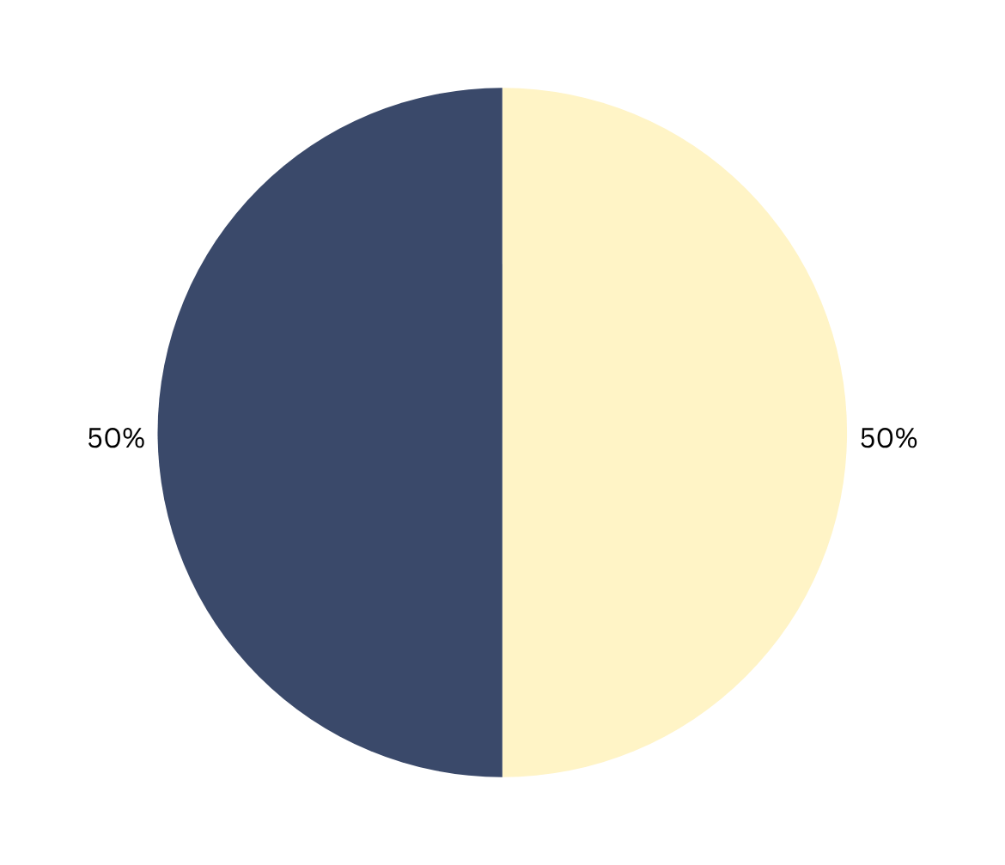

THE HIGH PRICE OF
DOING NOTHING
DO NOT
RETURN
RETURN
For district employees who are out on workers’ compensation for at least 6 months:

Slide 12
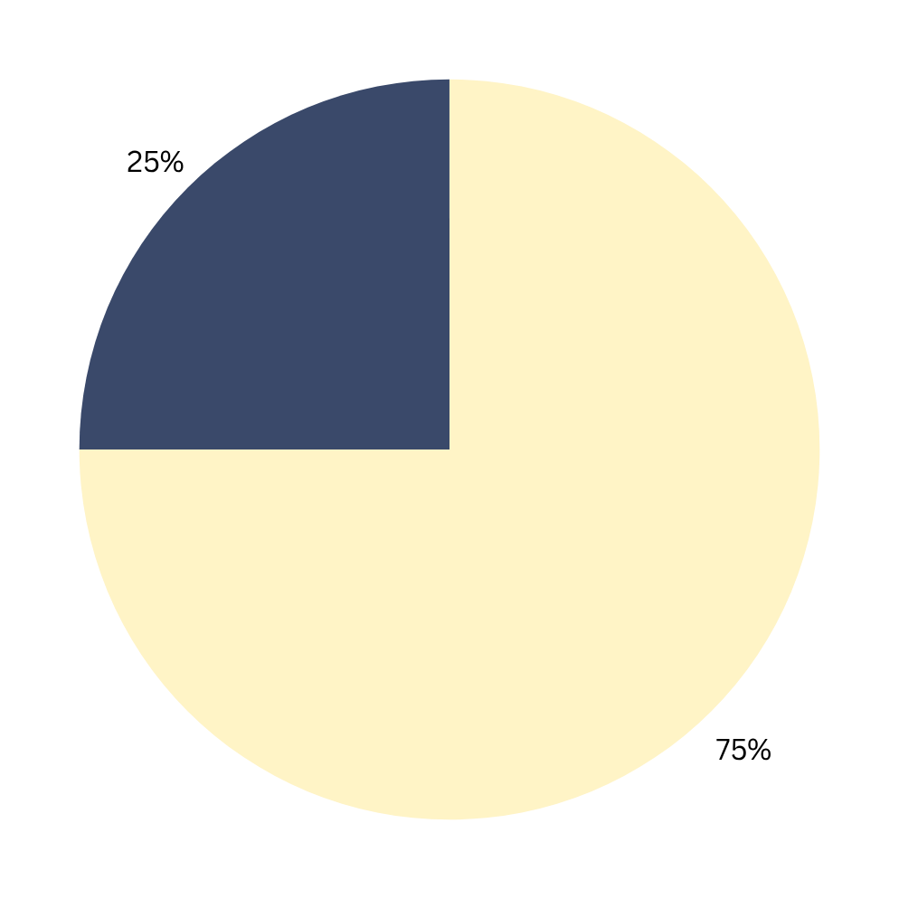
THE HIGH PRICE OF
DOING NOTHING
RETURN
For district employees who are out on workers’ compensation for at least 12 months:
DO NOT
RETURN

Slide 13
ON-GOING COMMUNICATION
IS CRITICAL
UNTIMELY COMMUNICATION CAN LEAD TO:
Prolonged recovery
Loss of trust
Escalated claims / litigation
Permanent separation from the workforce

Slide 14
WHY RETURN-TO-WORK
FOR DISTRICTS:
MATTERS
  Controls cost
  Retains experienced talent
  Reduces claim duration & drama
  Strengthens culture: Caring is smart business
When employees are hurt or healing, it doesn’t have to be “all or nothing.” With thoughtful accommodations, we can design a safe, supportive path forward.
FOR EMPLOYEES:
  Stays connected to school community
  Retains routine and purpose during recovery
  Heals faster, both mentally and physically

Slide 15
BRIDGE TO RECOVERY
MODIFIED WORK
Modified work is the heart of any successful RTW program.
Supporting employees in modified or transitional roles helps schools save on workers’ compensation costs and retain valuable staff.
Modified work is:
  Guided by doctors
  Supported by the schools
  Made possible by creativity and collaboration
It’s a ramp — not a catapult. No one’s getting launched back into full-duty unprepared.

Slide 16
BRIDGE TO RECOVERY
MODIFIED WORK
Transform your current program to encompass the three key T’s:
TRANSITIONAL
TEMPORARY
TAILORED

Slide 17
TASK ASSIGNMENT & MONITORING
CHECKLIST

Slide 18
TRANSITIONAL WORK
ASSIGNMENTS
Guided by doctors, supported by supervisors and made possible by creativity and collaboration.
ASSIGNMENTS:
  Fit their restrictions
  Can be part- or full-time
  Might be in another department
  Only temporary and medically safe
ELIGIBILITY:
  After a work injury
  Not permanently disabled
  Have been cleared for light or modified duty by a district-approved physician

Slide 19
STEP-BY-STEP
HOW IT WORKS
1
Medical Evaluation
  An approved physician outlines restrictions and timelines
Program Assessment
  The Workers’ Compensation Coordinator determines:
    Which tasks match medical restrictions
    Whether suitable assignments are available
2
3
Modified Work Assignment
  Temporary & flexible (within or outside usual dept)
  Medically safe (aligned with restrictions)
  Structured (full- or part-time)

Slide 20
RESPONSIBILITIES
EMPLOYEE
DISTRICT
LEGAL

Slide 21
EMPLOYEE
RESPONSIBILITIES
INJURED EMPLOYEES MUST:
Follow assigned duties
Attend all medical appointments
Report discomfort or setbacks
Maintain open communication during the RTW process

Slide 22
DISTRICT
RESPONSIBILITIES
DISTRICTS MUST:
Set clear expectations for attendance, communication, and performance
Coordinate all aspects of the return-to-work process
Maintain a “wish list” of tasks suitable for modified duty

Slide 23
LEGAL
RESPONSIBILITIES
THE PROGRAM COMPLIES WITH:
Federal and NJ state law
Collective bargaining agreements
The Americans with Disabilities Act (ADA)
All relevant labor laws

Slide 24
RETURN-TO-WORK
POLICY CREATION
EFFECTIVE POLICY:
  Include RTW guidelines in your employee handbook
  Provide a copy of the policy upon claim filing
  Collect signed acknowledgement for personnel files

Slide 25
RETURN-TO-WORK
POLICY CONSIDERATIONS
KEY ELEMENTS:
  JOB ANALYSIS
    Understand physical demands of each role
  ELIGIBILITY CRITERIA
    Align with medical advice and physician clearances
  TRANSPARENT COMMUNICATION
    Keep all participants updated
  COLLABORATIVE OVERSIGHT
    Include HR, supervisors, and medical staff

Slide 26
READY TO
RETURN TO WORK?
  MEDICAL EVALUATION
    Insights from workers’ compensation physician’s report
  EMPLOYEE CAPABILITIES
    What the injured staff member can safely do
  JOB AVAILABILITY
    Whether suitable modified tasks exist within the district
  OTHER LIMITATIONS
    Any additional factors affecting job assignment

Slide 27
TRANSITIONAL TASK ASSIGNMENT
FORM

Slide 28
PHYSICAL WORK CATEGORIES:
Sedentary: Negligible to 10 lbs. (done occasionally or frequently)
Light: Negligible to 20 lbs. (done occasionally to constantly)
Medium: 20–50 lbs. (may be done up to constantly)
Heavy: 50–100 lbs. (may be done up to constantly)
Very Heavy: Over 100 lbs. (may be done up to constantly)
FREQUENCY CODES (8 HOUR DAY):
N (None): 0 hours
O (Occasionally): Up to 2 hours, 40 minutes
F (Frequently): Up to 5 hours, 20 minutes
C (Constantly): Up to 8 hours

Slide 29
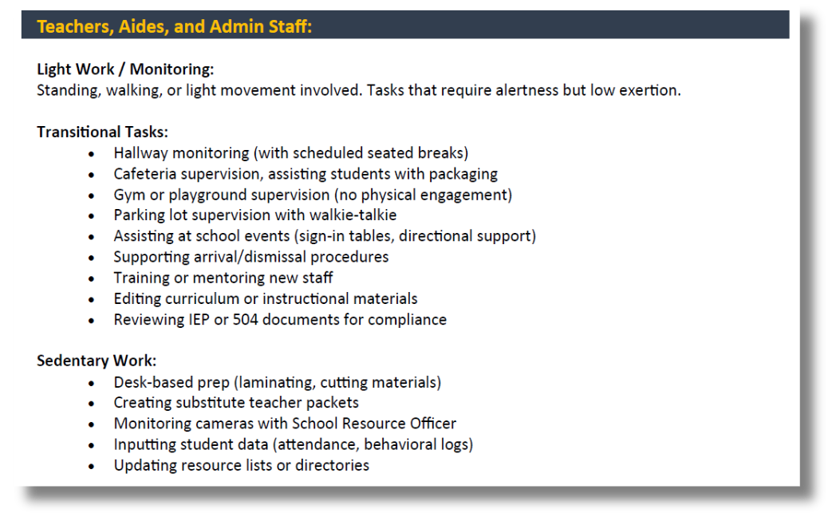
MAKING MODIFIED WORK,
WORK
  Create Accurate Job Descriptions
  Assess Physical Demands
  Build Individual Plans

Slide 30
TAILORED:
ONE SIZE DOESN’T FIT ALL
Not all injuries — or people — are the same.
  Creating effective modified work means:
    Matching restrictions to real tasks
    Using physical demand data
    Involving HR, the treating physician, the employee, the carrier, risk manager, nurse case manager, and legal staff.

Slide 31
COST
CONTAINMENT
Programs that support accident prevention and early return-to-work policies can significantly reduce WC costs.
  Create a return-to-work program to allow the district to benefit from new opportunities for task completion.
  Commit to open lines of communication.
  Develop a modified duty task list in advance that can evolve over time.
  Consult WC adjusters, nurses, medical professionals, HR, and legal counsel to ensure compliance with all applicable laws and regulations.

Slide 32
SCENARIOS
SCENARIO 1
SCENARIO 2
SCENARIO 3
Stuck at home,
losing hope
Employee refusal
Employee questions
SCENARIO 4
SCENARIO 5
Employee re-injured
No accommodations

Slide 33
SCENARIO 1
Stuck at home,
losing hope
PROBLEM:
An injured custodian cleared for light duty waits weeks for an assignment - becoming isolated and considering legal action.
SOLUTION:
Assign simple, low-risk tasks (e.g., seated inventory) immediately to keep them engaged.

Slide 34
SCENARIO 2
Employee refusal
PROBLEM:
A paraeducator declines a modified role, saying it “doesn’t feel like real work.”
Employee refusal
SOLUTION:
Document the offer, medical clearance, job duties, and start date. In many cases, refusing light duty may affect benefits.

Slide 35
SCENARIO 3
Employee questions
PROBLEM:
An injured worker cannot reach their adjuster and grows frustrated.
Employee refusal
SOLUTION:
Appoint a district liaison to explain basic processes, provide updates, and direct questions appropriately.

Slide 36
SCENARIO 4
Employee re-injured
PROBLEM:
A staff member on light duty reports new pain.
Employee refusal
SOLUTION:
Treat it like any other work-related injury - document and report it promptly.

Slide 37
SCENARIO 5
No accommodations
PROBLEM:
Doctor clears an employee for only 4 hours/day, no lifting, no standing.
Employee refusal
SOLUTION:
If duties cannot be accommodated, consider short-term disability or external placement until they improve.

Slide 38
LET’S GET STARTED
PROGRESS OVER PERFECTION
  Start small. Start smart. Use what you have.
  This is a process — not a pop quiz.
  Every thoughtful change makes a difference.
INSTEAD OF SAYING: “We don’t accommodate modified duty.”
TRY: “Let’s explore every option to find a safe and meaningful fit for our employee.”

Slide 39

THANK YOU
JILL DEITCH, ESQ.
Executive Director, NJSIG
jdeitch@njsig.org
JOANNA RADOMICKI
Member Services and Loss Control Representative
jradomicki@njsig.org
Scan the QR code for more information

